Slide 1


Impact of Social Sciences, Humanities and Arts Conference
The Roundtable Session on:
Cross-border Alliances in Transdisciplinary Research
14 October, 2021

Slide 2
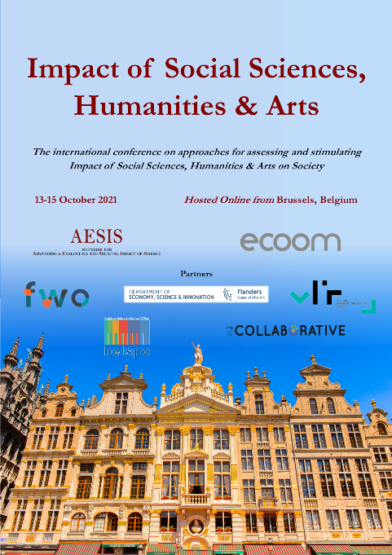

Impact of Social Sciences, Humanities and Arts
13-15 October, 2021
Otto Bruun: Chairman, UAS4EUROPE Management Committee
Hannes Raffaseder: Chief R&I Officer, FH St. Pölten, EURASHE Board Member, & Coordinator of European University E³UDRES², Austria
Frank Kresin: Dean of Faculty of Digital Media and Creative Industries, Amsterdam University of Applied Sciences, the Netherlands
Overview of the Coordinators
#SSHA21

Slide 3
Impact of Social Sciences, Humanities and Arts
13-15 October, 2021
Hannes Raffaseder
Chief R&I Officer, FH St. Pölten, EURASHE Board Member, & Coordinator of European University E³UDRES², Austria
#SSHA21

Slide 4
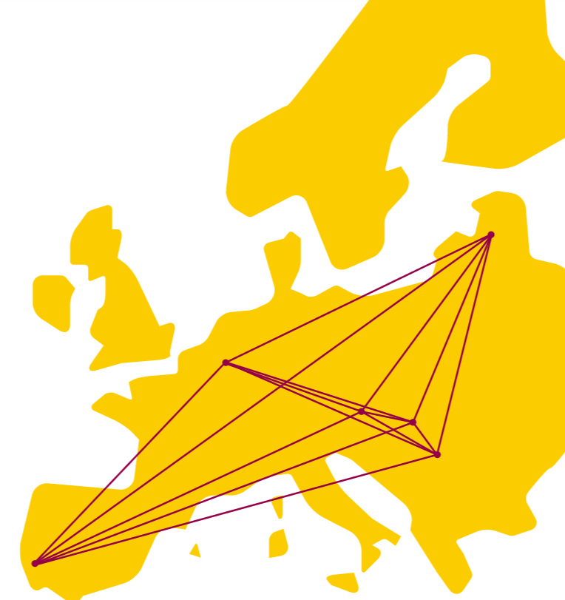

General information

Slide 5

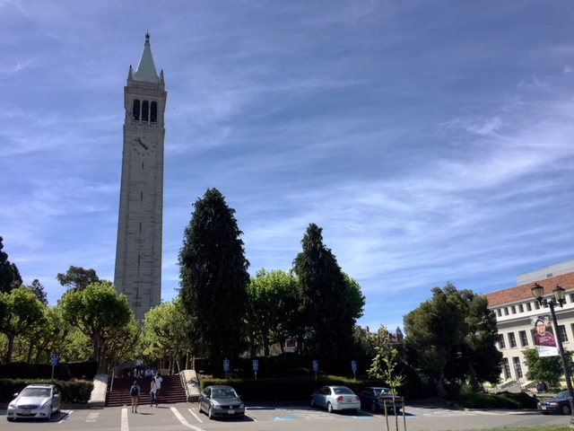
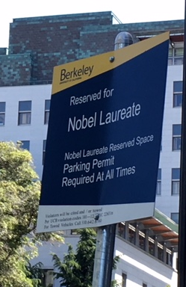
Universities?

Slide 6
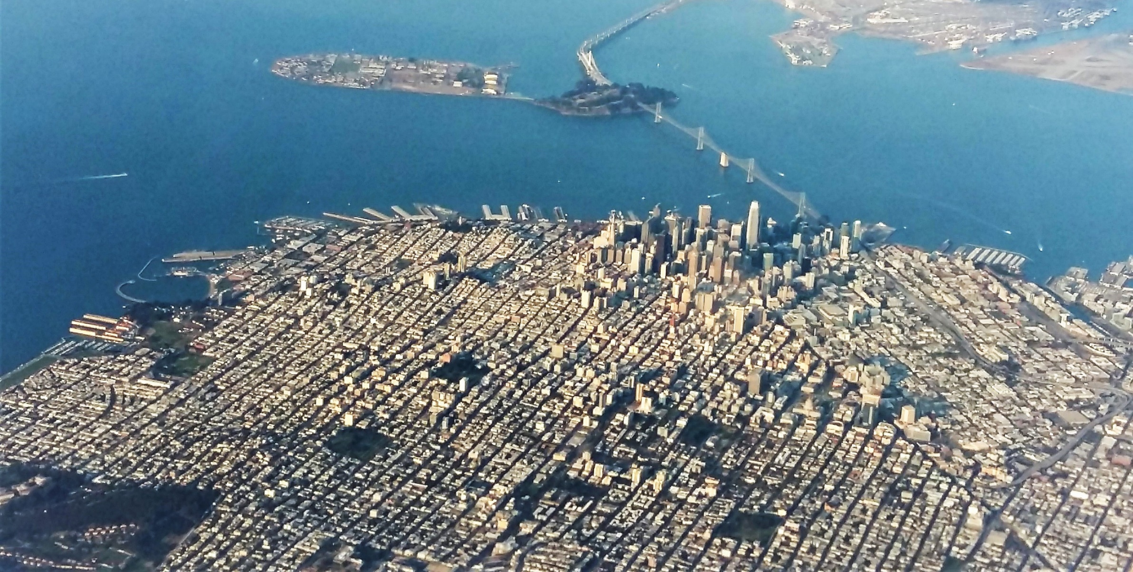
Innovation Ecosystems?

Slide 7




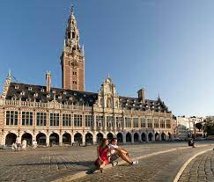
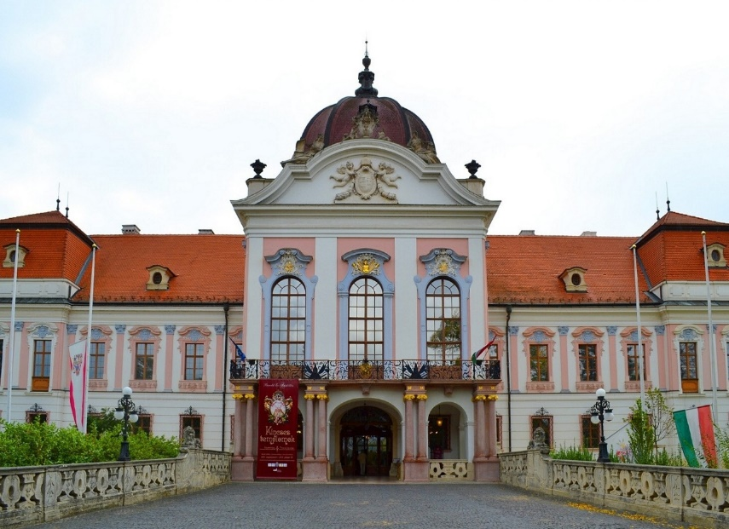
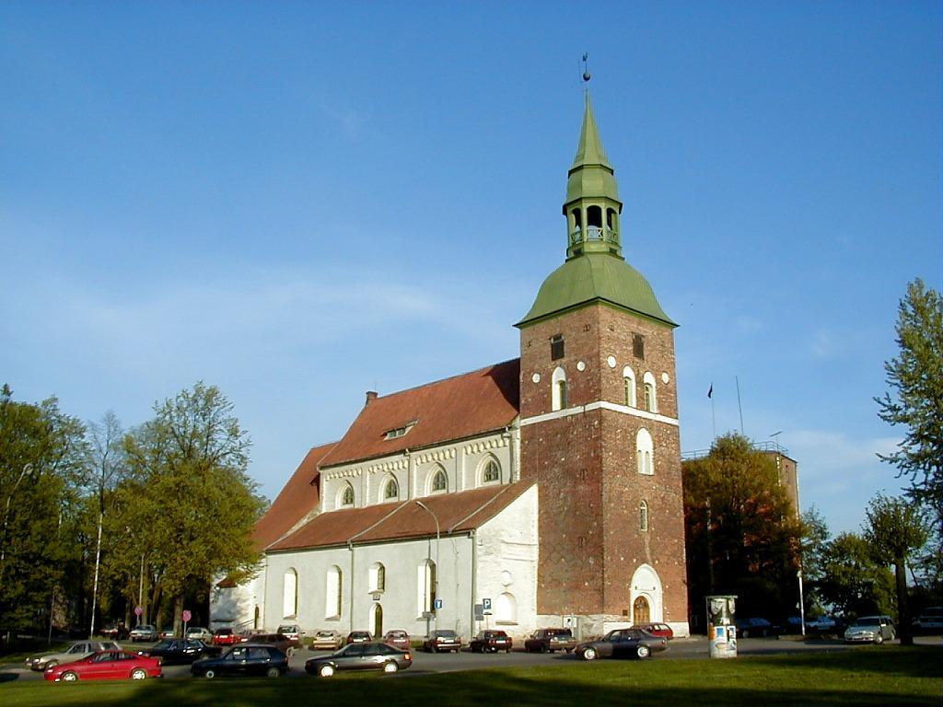
Towards a Future European University
For Smart and Sustainable Regions
Universities?

Slide 8
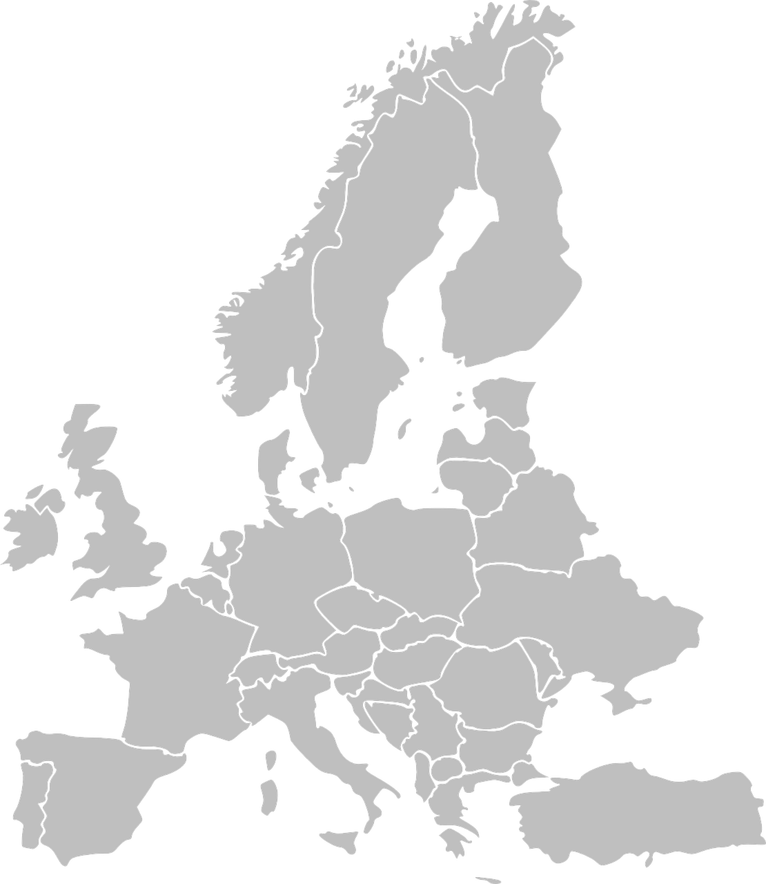
Engaged & Entrepreneurial
European University as Driver for European
Smart and Sustainable Regions
E³UDRES² is the

Slide 9
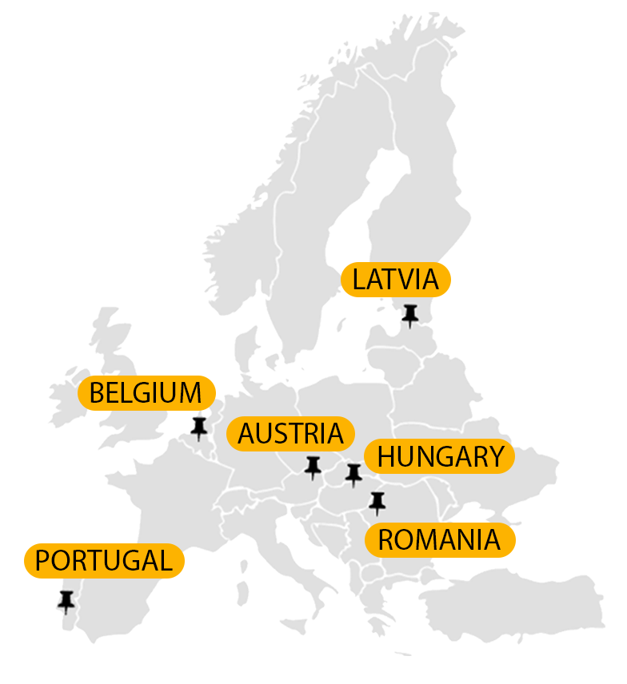
AUSTRIA
St. Pölten University Of Applied Sciences (Lead)
https://fhstp.ac.at/
PORTUGAL
Instituto Politécnico de Setúbal
https://www.ips.pt/
HUNGARY
Hungarian University of Agriculture and Life Sciences
https://www.uni-mate.hu/hu
BELGIUM
University Colleges Leuven-Limburg
https://www.ucll.be/
ROMANIA
Politehnica University Timișoara
http://www.upt.ro/
LATVIA
Vidzeme University of Applied Sciences
https://va.lv/

Slide 10
E³UDRES² Vision
E³UDRES promotes the development of small and medium-sized cities and their rural areas into smart and sustainable regions
E³UDRES shapes a prosperous future with the best possible quality of life for a self-determined people in a progressive European society
E³UDRES promotes outstanding ideas and concepts for future universities, integrates challenge-based and future-proof learning, mission-oriented research, human-centered innovation as well as open and engaged knowledge exchange as interrelated core areas
E³UDRES establishes an exemplary multi-university campus across Europe

Slide 11
E³UDRES² focuses on
Co-Innovation of Smart & Sustainable European Regions
Co-Ideation of a Future University
Co-Creation
of a European Multi-University Campus

Slide 12
Future University: Four Interrelated Missions
Challenge
Based
EDUCATION
Human centered
INNOVATION
Open & Engaged
KNOWLEDGE TRANSFER
Mission oriented
RESEARCH

Slide 13
THREE FoCUS AREAS TOWARDS Smart & Sustainable Regions
Circular Economy
Wellbeeing
Human Contribution to Artificial Intelligence
These focus areas are dealt with in:
I-Living Labs (students collaborate with regional and European stakeholders)
I-Research Networks (experienced researchers collaborate with regional and European stakeholders)
Innovation (hackathons, bootcamps, rural residencies,…)
…

Slide 14
Future University: A New Inspiring I-Culture
Real | virtual | living labs | infrastructure |
Future (work) skills | cross-dsiciplinary, cross-sectoral, cross-actor innovation | regional-anchored – globally connected |
I-Culture
Interdisciplinay
International
Intercultural
Interrellated
Innovative
New. Environments
New.Content
Team spirit | mutual trust | partnership | transparent communication | promotion of talents | individual contributions to the common goals | consideration of individual poetentials and challenges |
Mission-oriented research | multidirectional knowledge exchange | thinking out of the box | practice-oriented |
E³UDRES²
New.Collaboration
New.Perspectives
New Content
New Perspectives
New Methods
New Organisation
New Collaboration
New Environments
Inter-interinstitutional research groups | strategic advisory board | students union |
Open Innovation | Open Science | Citizen Science | Responsible Research | experimental, engaged, project-based, resarch-focused learning |
New.Organisation
New.Methods

Slide 16
Impact of Social Sciences, Humanities and Arts
13-15 October, 2021
Thank you!
#SSHA21

